Slide 1
Service-Oriented Architecture (SOA) and APIs
SE495: Software and Systems Integration

Slide 2
Outline
Service-Oriented Architecture (SOA)
Principles of SOA
Components of SOA
APIs and web services
API management and documentation

Slide 3
Service-Oriented Architecture (SOA)

Slide 4
Enterprise Systems:
Perform enterprise activities
Management
and Support
Application Systems:
support enterprise systems
Interoperability
Distributed Computing Platform
Application Support Services (OS,
DB support, Directories, RPC)
Communication Network Services
(Network protocols, Physical devices)
Hardware
Portability
Integration
Network
Management
4

Slide 5
Enterprise Systems:
Engineering systems
Business systems
Manufacturing
Office systems
Management
and Support
Interoperability
Application Systems:
User
Interfaces
Processing
programs
Data files &
Databases
Portability
Distributed Computing Platform
Application Support Services
Integration
C/S Support
Dist. Data
Trans. Mgmt.
Distributed
OS
Network
Management
Common Network Services
Network protocols & interconnectivity
OSI
protocols
TCP/IP
5

Slide 6
Client-Server (Two-Tier) Architectures
The application is modelled as a set of services that are provided by servers and a set of clients that use these services;
Clients know of servers but servers need not to know of clients;
Clients and servers are logical processes: They could reside/running on different processors or on the same processor;
The mapping of processors to processes is not necessarily one to one.

Slide 7
Client-Server Systems and their Federation
Server
Virtualization of services
Virtual server A
Server
2
Server
1
Multi tenancy / Loadbalancer
database
Cloud Computing
Federation
A server also manages the database
Virtualization of services
Virtual server B
Server
3
Server
4
Multi tenancy / Loadbalancer

Slide 8
Thin-Client and Fat-Client Architectures
Thin-client architecture
All of the application processing and data management are carried out on the server.
The client is simply responsible for running the presentation/GUI software.
Fat-client (Thick-client) architecture
The software on the client implements the application logic and the interactions with the users.
The server is responsible for data management (database) only.
Example: Many game programs, Adobe Flash and MS Silverlight support Fat Clients, HTML5 can also support Fat Clients, where intensive processing and responsiveness are required.

Slide 9
Traditional Three-Tier Architecture
Each layer may execute on a separate processor;
A more balanced approach, which allows for better performance than a thin-client approach and is simpler to manage than a fat-client approach;
A more scalable architecture - as demands increase, extra servers can be added.
Presentation
Layer (GUI)
Application
Processing Layer
Data Management
Layer

Slide 10
Example: A 3-Tier Internet Banking System
Client
Client
Client
HTTP
HTTPS
Web Server
for account
service
provision
Data Management Layer
Client
Database server
Customer
account
database
Presentation Layer
in Client Browsers
Business Logic Layer
in server
Database requests and responses

Slide 11
Four-Tier Architecture with a Service Layer
Each layer may execute on a separate processor;
Application is largely composed of existing services, running on a different server (repository), provided by external service providers;
This is an example of Service-Oriented Architecture (SOA);
SOA does not have to be in N-Tier. It can be a tree or graph too.
Presentation
Layer (GUI)
Not accessible outside
Application
Processing Layer
In-App Data
Management
Service Repository
Layer
Data
Management
Data Management
Layer outside App
Shared by many applications

Slide 12
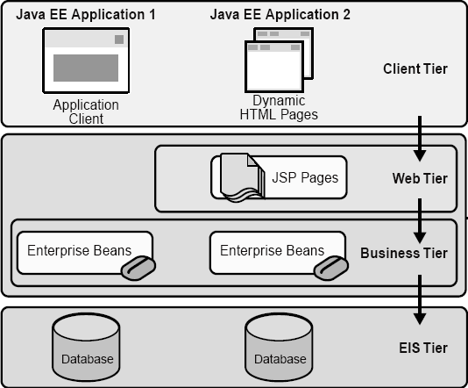
Four-Tier Architecture: Java EE Application Source: Java Enterprise Edition
Client Machine
Java EE Server
Enterprise
Information
System
EIS Database
Server

Slide 13
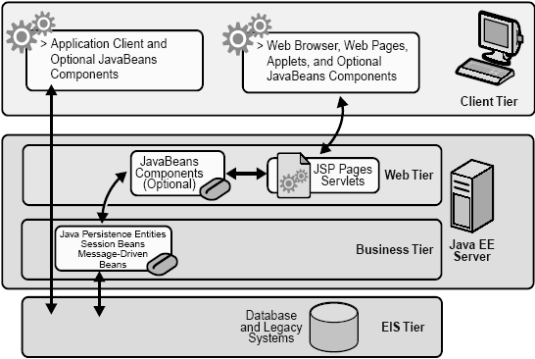
Java EE Application (not strictly tiered)
Thick client
Thin client

Slide 14
Service-Oriented Architecture (SOA)
Service-Oriented Architecture (SOA) is a software architecture design that utilizes modular, reusable, and interoperable services to support the requirements of business processes and users.
In an SOA, software services are designed to be self-contained, independent components that can be easily integrated with other services to create complex business applications.
These services communicate with each other through standardized interfaces, allowing them to be used in multiple contexts and across different technology platforms.
The goal of SOA is to create a flexible, scalable, and dynamic IT infrastructure that enables organizations to quickly adapt to changing business needs and requirements.

Slide 15
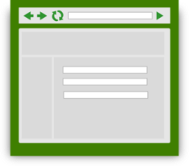
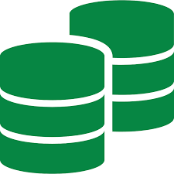
Monolithic Application Conceptual Model
Scripts/ Third Party Systems
User Interfaces
API endpoints
Web service
Presentation Layer
Application software Business Logic
Run time libraries
Database Engine
Table
Table
Table
Table
Table
Table
Table
Table
Table
Table
Table
Table
Table
Table
Table
Table

Slide 16
Services-oriented Architecture
Longstanding approach to business application development
Monolithic application based on reusable services
Complex applications rely on an enterprise service bus to manage communications among services, database connectivity, event triggers, etc
Single uniform technology platform
Code assembled into a monolithic package
Scales to very high performance through clustered deployment

Slide 17
SOA development issues
Services are closely interrelated throughout the application
Developers must understand all aspects of the application
Single technology stack
Small changes require full recompilation
Complex applications can hit hardware or OS limits
Centralized development pattern
Operations separated from Development

Slide 18
Monolithic Application: Enterprise SOA Model
Scripts/ Third Party Systems
User Interfaces
API endpoints
Web service
Presentation Layer
Application software Business Logic
}
Reusable
Composable Services
Enterprise Service Bus
Database Engine
Table
Table
Table
Table
Table
Table
Table
Table
Table
Table
Table
Table
Table
Table
Table
Table

Slide 19
Distributed Development: Separation of Responsibility
The Three-Party Model of Service-Oriented Software Development
Not a part of the model
Developers who understand database, ontology, searching, and matching
End user
White pages
Yellow pages
Traditional object-oriented programmers, active objects hosting
Software engineers who understand the application domain
Service brokers
Green pages
Registry
Registry
Service repository
Internet
Application builders
Service providers
Applications
Active Objects
Service requesters
Service developers

Slide 20
A Scenario of the SO Software Development and Tools
Programming
languages:
C++, C#
Java, Python
Directory of services
UDDI / WSDL / SOAP
ebXML, RDF/S, OWL
Ontology
(3) Registering
Service
Development Envir:
Visual Studio, Flask, Django
Java EE / Eclipse / NetBeans
Service brokers
Registry
Registry
(5) Found
(2) Publishing
Internet
(4) Finding
Application builder
Service providers
(6) Binding
(7) SOAP/HTTP call
(1) Developing
Applications
Active Objects
(8) Results
Application development platforms
Specification languages VS, WebSphere, SCA/SDO, WF, WSFL, BPEL, Django for composition, code generation, in addition to use programming languages
Using Web Service standards:
XML, WSDL, RDF, OWL, ontology

Slide 21
Web Services in Web Applications
Brokers
Application builders
Service Directory
UDDI or ebXML
Other Web
Services
Service
requesters
SOAP/HTTP
Global Data
WSDL Interface
Local Data
Service / Object
Database and Ontology
IDE (.Net or Java EE)
Big Data
Programming languages
Data Infrastructure
Web Services
Service hosting infrastructure, e.g., servers or cloud computing
A program consists of algorithms and data

Slide 22
Definitions and Terminologies
A service is the interface between the producer and the consumer.
From the service provider's point of view, a service is a function module that is well-defined, self-contained, and does not depend on the context or state of other functions. A service is often implemented by an active object.
Services can be newly developed modules or just wrapped around existing (legacy) software to give them new interfaces.
From the application builder's point of view, a service is a unit of work done by a service provider to achieve desired end results for a service consumer (an application builder, not an end user).
A service normally does not have the human user's interface. Instead, it provides loosely coupled Application Programming Interface (API), with standard interface, so that a service can be discovered and invoked by a computer program.
For human users (end users) to use services, a (graphic) user interface needs to be added – forming a (Web) application.

Slide 23
Definitions and Terminologies (contd.)
Service-Oriented Architecture (SOA): Software consisting of a collection of loosely coupled and platform-independent services that communicate with each other through standard interfaces. SOA does not concern developing operational software.
Service-Oriented Computing (SOC) refers to the paradigm that represents computation in SOA. A level deeper than SOA, incl. algorithms and data structures.
SOA and SOC are often used interchangeably.
Web Services are services accessible over the Web. As an architecture, it refers to Web-based SOA and a set of enabling Web technologies, including XML, JSON, SOAP, WSDL, HTTP, UDDI, and ebXML. Two types of Web services:
SOAP/WSDL Services (heavy duty services)
RESTful Services (lightweight or micro services)

Slide 24
Definitions and Terminologies (contd.)
Service-Oriented Development (SOD)
concerns the entire software development cycle based on SOA concepts and SOC paradigm.
involves current technologies and tools to effectively produce operational software:
Development environments: VS, Java EE, Flask, Django, NetBeans, WebSphere, etc.;
Databases, SQL, Oracle, BD, XML DB, etc.;
Deployment and hosting environment: Server, cloud: SoD, AWS Cloud, Google Cloud, MS Azure, etc.

Slide 25
OO Development versus SO Development
SO Protocols/
Languages
SO Concepts
SO IDEs/Tools
SO Development Cycles
Service
orientation
Loosely
coupled
Remote binding
Dynamic composition
Standard interfaces
XML
WSDL
SOAP
RDF
OWL
BPEL
SCA/SDO
PSML
Visual Studio
Flask, Django NetBeans
Oracle SOA suite
JDeveloper
Java EE
WebSphere
ebXML
Service development in OOC
Interface definition / wrapping
Service hosting / registration
Application specification
Service search
Remote binding
Operation
Dynamic configuration
Directory
Repository
Ontology
Match
OO Concepts
OO Languages
OO IDEs/Tools
OO Development Cycle
Object
orientation
Inheritance
Polymorphism
Dynamic
binding
C++
C#
Objective C
Java
Python
Smalltalk
CORBA
Eclipse
UML
GCC
Visual Studio
Specification/Modeling
Verification/Model checking
Design / Coding
Validation / Testing
Operation
Maintenance

Slide 26
Component-Based Development
Bricks and Tiles
Traditional
Component-based

Slide 27
Component-Based Software Development
Organization X:
Component library
Organization Y:
Component library

Slide 28
Service-Oriented Software Development
Design Pattern?
Application
proxy
proxy
proxy
proxy
proxy
Auto-searchable
Found
Standard
Interface
Service broker
Registration
Organization X:
Component library
Organization Y:
Component library
Organization Z:
Component library

Slide 29
Principles of SOA

Slide 30
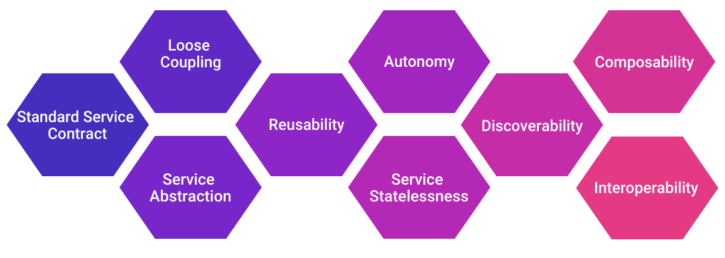
Principles of SOA
Service-Oriented Architecture (SOA) is a software architecture design that emphasizes the use of loosely coupled, reusable software services to support the requirements of business processes and users.

Slide 31
Principles of SOA
Service contract
Services in an SOA have a formal contract that defines their functionality, inputs, and outputs. This contract is agreed upon by both the service provider and the service consumer and serves as the basis for the interaction between them.
Loose coupling
Services in an SOA are loosely coupled, which means that they operate independently of each other and do not depend on specific implementation details of other services. This allows for greater flexibility and scalability within the system.

Slide 32
Principles of SOA
Reusability
Services in an SOA are designed to be reusable, which means that they can be used in different contexts and for different business processes. This reduces development time and costs and promotes consistency across different parts of the system.
Composability
Services in an SOA are designed to be composable, which means that they can be combined to create more complex business processes. This allows for greater flexibility and agility in responding to changing business requirements.

Slide 33
Principles of SOA
Abstraction
Services in an SOA are designed to be abstracted, which means that they hide implementation details from service consumers. This promotes simplicity and ease of use for service consumers.
Interoperability
Services in an SOA are designed to be interoperable, which means that they can communicate with otherservices and systems regardless of the technology platform or programming language used. This promotes integration and collaboration between different systems and organizations.

Slide 34
Principles of SOA
Autonomy
Services in an SOA are designed to be autonomous, which means that they have control over their own functionality and behavior. This allows services to operate independently, reducing dependencies and promoting flexibility and scalability.
Statelessness
Services in an SOA are designed to be stateless, which means that they do not store information about previous interactions with a service consumer. This promotes simplicity and enables services to be easily scaled and replicated.

Slide 35
Components of SOA

Slide 36
Components of SOA
Service provider
A service provider is responsible for creating and hosting a service that can be accessed by other components in the SOA. The service provider defines the service contract, which outlines the functionality, inputs, and outputs of the service.
Service registry
A service registry is a repository that stores information about available services in the SOA. It allows service consumers to discover and access services provided by the service provider.

Slide 37
Components of SOA
Service consumer
A service consumer is a component that accesses and uses services provided by the service provider. The service consumer sends requests to the service provider and receives responses back.
Service bus
A service bus is a middleware component that facilitates communication between services in the SOA. It provides routing, transformation, and other functions that allow services to work together seamlessly.

Slide 38
Components of SOA
Service contract
A service contract is a formal agreement between the service provider and the service consumer that defines the interface and behavior of the service. It includes information such as the service name, operations, parameters, and data types.
Service interface
A service interface is the set of operations and messages that a service provides to its consumers. It defines the way in which a service can be accessed and used by other components in the SOA.
Service endpoint
A service endpoint is the location where a service can be accessed by a consumer. It includes information such as the service URL, protocol, and transport bindings.

Slide 39
APIs and web services

Slide 40
Introduction
APIs (Application Programming Interfaces) and web services are both technologies that allow different applications to communicate with each other over the internet.
APIs are sets of protocols, routines, and tools used to build software applications.
An API defines how different software components should interact with each other, allowing code from one application to be used in another application in a standardized and controlled way.
APIs allow developers to access functionalities of a specific software or service without having to understand the underlying implementation details.

Slide 41
What is API?
Request
App A
App B
Response
Client
Server

Slide 42
Introduction
Web services, on the other hand, are a specific type of API that use standardized protocols such as HTTP, XML, and SOAP to exchange information and perform specific functions over the internet.
Web services are designed to be platform-agnostic and can be accessed from any programming language or technology platform, making them highly interoperable.

Slide 43
API Fundamentals
APIs provide a set of rules and protocols for building software components that can be easily integrated with other software components.
APIs typically include a set of programming instructions, data structures, and communication protocols that allow developers to access the functionalities of a specific software or service without having to understand the underlying implementation details.
APIs are used extensively in modern software development to create modular and scalable applications.
They allow developers to build complex software systems by combining and reusing smaller, more focused software components.
APIs can be designed for internal use within an organization, or they can be made available publicly for other developers to use.

Slide 44
Application Programming Interfaces (APIs)
An API defines how software can be used by other software.
The API for a code library is the list of functions/classes it provides.
Software services provide network remote procedure call (RPC) APIs.
Network-level APIs can have any format, but most commonly:
REST built on top of HTTP
SOAP (old)
Thrift binary protocols, more efficient than REST.
Protocol buffers
GraphQL
Usually includes some form of authentication:
Service must identify you to give access or personalized data.

Slide 45
REST
REST (Representational State Transfer) API is a popular architectural style for building web services that use HTTP to communicate between applications.
REST APIs are designed to be lightweight and scalable, and they use standard HTTP methods such as GET, POST, PUT, and DELETE to interact with resources.
REST APIs typically use JSON or XML as the data format for exchanging information.

Slide 46
RESTful Web Service
HTTP
App A
App B
HTTP
Client
JSON
Server

Slide 47
REST API example
Twitter REST API documentation
https://developer.twitter.com/en/docs/tweets/post-and-engage/api-reference/post-statuses-update
Elastic Search: https://www.elastic.co/guide/en/elasticsearch/reference/current/rest-apis.html
Discourse web forum public API documentation:
https://docs.discourse.org
Output examples, viewable in a web browser:
https://meta.discourse.org/categories.json
https://meta.discourse.org/latest.json?category=7
https://meta.discourse.org/t/3423.json (requires authentication)
http://ssa-hw2-backend.stevetarzia.com/api/search?query=northwestern&date=2020-04-16

Slide 48
SOAP
SOAP (Simple Object Access Protocol) API is a protocol for exchanging structured information between applications over the internet.
SOAP APIs use XML to encode the message and communicate via HTTP or other protocols.
SOAP APIs are designed to be more secure and transactional than REST APIs, but they can also be more complex and heavyweight.

Slide 49
SOAP Web Service
SOAP
App A
App B
SOAP
Client
XML
Server

Slide 50
RESTful and SOAP services
Feature | RESTful Services | SOAP Services
Protocol | HTTP | SOAP
Message Format | XML | XML
Verbs | GET, POST, PUT, DELETE | None
Messaging Style | Messaging | Document-based
Latency | Low | High
Complexity | Simple | Complex

Slide 51
GraphQL
GraphQL API is a query language for APIs that was developed by Facebook.
GraphQL APIs allow clients to specify exactly what data they need, making them more efficient and flexible than traditional REST APIs.
GraphQL APIs use a single endpoint to retrieve all the data required by a client, which can reduce the number of requests needed to retrieve data.

Slide 52
API endpoints and methods
API Endpoint:
An API endpoint is a specific URL that a client can use to access a specific API resource.
Endpoints are the entry point for an API and specify the location where clients can access the API's functionalities.
For example, an endpoint for a weather API might be "https://api.weather.com/forecast", which would allow a client to retrieve weather forecast data from the API.
Endpoints can also include variables and query parameters to allow for more specific requests.

Slide 53
API endpoints and methods
API Methods:
API methods, also known as HTTP methods or verbs, are the standard requests that a client can make to interact with an API endpoint.
The most common API methods are:
GET: retrieves information from an API endpoint. For example, a GET request to a weather API endpoint might return the current temperature and weather conditions.
POST: sends new data to an API endpoint to create a new resource. For example, a POST request to a user registration API endpoint might create a new user account.
PUT: updates an existing resource in an API endpoint. For example, a PUT request to a user profile API endpoint might update the user's email address.
DELETE: removes an existing resource from an API endpoint. For example, a DELETE request to a user profile API endpoint might delete the user's account.

Slide 54
Web Service Fundamentals
A web service is a software system designed to support interoperable machine-to-machine interaction over a network.
Web services use standardized protocols like HTTP, XML, and SOAP to exchange information and perform specific functions over the internet.
Web services typically have an interface that is described in a formal description language, such as WSDL (Web Services Description Language), which defines the operations supported by the web service, the input parameters and output values, and the message format.
This description is used by clients to understand how to interact with the web service and to generate code to access the service.

Slide 55
Web Service Fundamentals
Web services are designed to be platform-agnostic and can be accessed from any programming language or technology platform.
This means that web services can be used to integrate disparate software systems and allow them to communicate with each other, even if they are running on different operating systems or technologies.
Web services can be classified into two main types: SOAP (Simple Object Access Protocol) and REST (Representational State Transfer). S
OAP web services use XML-based messaging to exchange information, while REST web services use HTTP and other web standards to exchange data in a lightweight and efficient way.

Slide 56
Web Service (WS)
Web Services are building blocks of SOC software
SOAP/WSDL services have an standard interface in WSDL
RESTful services use HTTP without using SOAP/WSDL
WS can be remotely invoked via a message in a standard protocol, e.g., SOAP, HTTP – It is NOT a remote procedure call
Loosely coupled vs. tightly coupled
Data flow vs. control flow
Web Services are platform-independent, it can be written in any languages: Java, C#, C++, Python, etc.
Every piece of program can be wrapped into a WS
Every WS can be placed in an internet-searchable repository
In the near future, most services required will be available (not necessarily free). There is less need of writing new services. However, there is always a need of writing better services.

Slide 57
Main Web Service Authoring Tools
C# Web Services on Visual Studio
Java Web Services
Python Web Services

Slide 58
Web Services are Wrapped Classes/Objects
Return value in XML/SOAP/HTTP
To UDDI server
Service
requester
Remote invocation in
XML/SOAP/HTTP
WSDL Description for UDDI publication
RESTful
Reactor
Web service interfaces in WSDL
Automatically
generate the
Service interfaces
Function call
Return value
Service agent
Functions/Methods written in C# / Java / Python
Manually write the functions/methods in the classes in C# or in Java, each function corresponds to a service

Slide 59
Web Services Types
SOAP web services use the XML-based SOAP protocol to exchange information between applications.
SOAP web services typically use WSDL (Web Services Description Language) to describe the interface of the service and define the operations that can be performed.
SOAP web services are designed to be highly secure and reliable, but they can also be more complex and heavyweight than other types of web services.

Slide 60
Web Services Types
RESTful web services use the HTTP protocol and other web standards to exchange data between applications.
REST is an architectural style that emphasizes simplicity, scalability, and interoperability.
RESTful web services typically use JSON (JavaScript Object Notation) or XML to exchange data, and they use HTTP methods (GET, POST, PUT, DELETE) to interact with resources.
RESTful web services are designed to be lightweight and efficient, but they may not be as secure as SOAP web services.

Slide 61
API and Web Service Integration
API Gateway: An API gateway is a server that acts as an intermediary between a client application and a set of APIs.
The API gateway provides a single entry point for clients to access multiple APIs, and it can handle tasks such as authentication, rate limiting, and request routing.
API gateways can help simplify the integration of APIs with other software systems by providing a unified interface.
API Proxies: An API proxy is a layer that sits between a client application and an API.
The proxy intercepts requests from the client and routes them to the API, and it can perform tasks such as caching, transformation, and security enforcement.
API proxies can help improve the performance and security of APIs by providing additional functionality and control.

Slide 62
API and Web Service Integration
SDKs (Software Development Kits): SDKs are collections of pre-built libraries, code snippets, and tools that developers can use to integrate APIs and web services into their applications.
SDKs can simplify the integration process by providing pre-built functionality for common tasks such as authentication, data validation, and error handling.
Webhooks: Webhooks are a way for one application to provide real-time notifications to another application.
When a specific event occurs in the first application, it sends a message to a predefined URL in the second application.
Webhooks can be used to trigger actions in responseto events, such as updating a database or sending a notification.

Slide 63
API and Web Service Integration
Integration Platforms: Integration platforms are tools that provide a platform for integrating APIs and web services with other software systems.
Integration platforms typically have a visual interface for connecting APIs and services, and they can handle tasks such as data mapping, transformation, and workflow automation.
Integration platforms can help simplify the integration process by providing a unified platform for managing and monitoring integrations.

Slide 64
Integration/Composition
How services can interact over the network?
APIs:
Commands- actions, synchronous
Messages- request for information, no state change, synchronous
Events: facts and notifications, asynchronous
Streams: a sequence of events/data elements made available over time

Slide 65
Types
Learn the differences between an event-driven streaming platform like Apache Kafka and middleware like Message Queues (MQ), Extract-Transform-Load (ETL) and Enterprise Service Bus (ESB).
Including best practices and anti-patterns, but also how these concepts and tools complement each other in an enterprise architecture.

Slide 66
Problems of Legacy Middleware
Extract-Transform-Load (ETL) is still a widely-used pattern to move data between different systems via batch processing.
Due to its challenges in today’s world where real time is the new standard, an Enterprise Service Bus (ESB) is used in many enterprises as integration backbone between any kind of microservice, legacy application or cloud service to move data via SOAP / REST Web Services or other technologies.
Stream Processing is often added as its own component in the enterprise architecture for correlation of different events to implement contextual rules and stateful analytics.
Using all these components introduces challenges and complexities in development and operations.

Slide 67
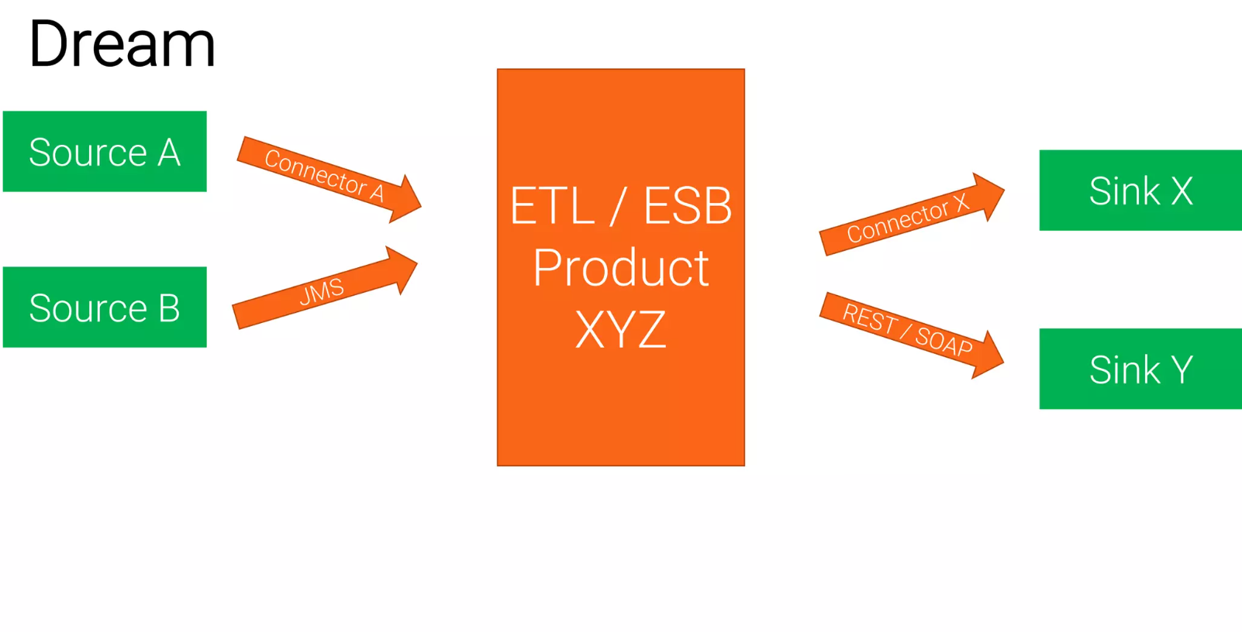
Traditional Middleware

Slide 68
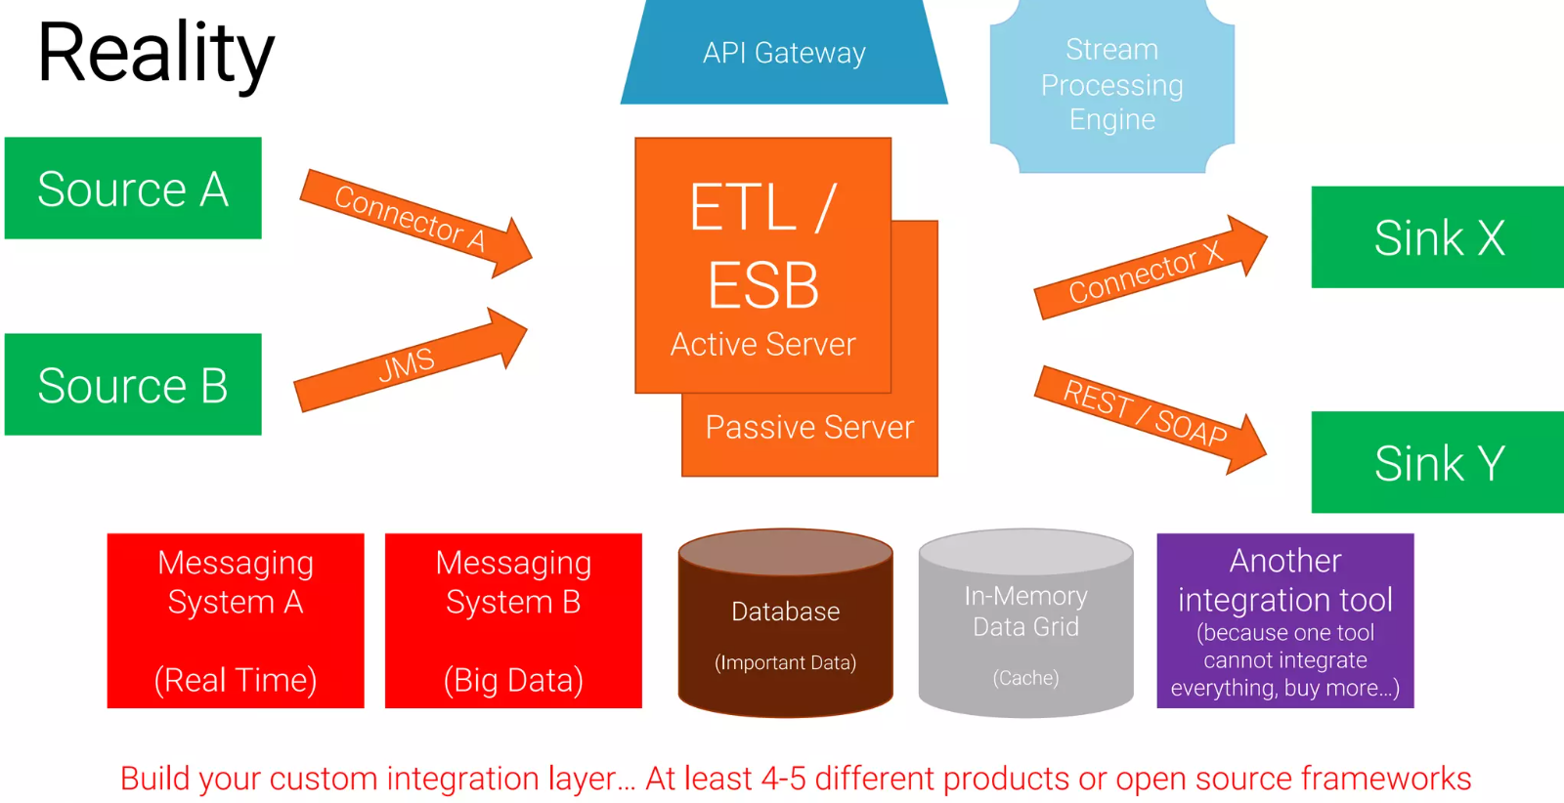
Traditional Middleware

Slide 69
Challenges (MQ, ETL, ESB)
Zoo of technologies
Integration platform (ETL/ESB) + additional optional components
Database
APIs
Architecture with limited scalability and availability
No end-to-end, no native built-in scalability
Downtime for maintenance
Tight Coupling
No separation of concerns and vendor lock-in

Slide 70
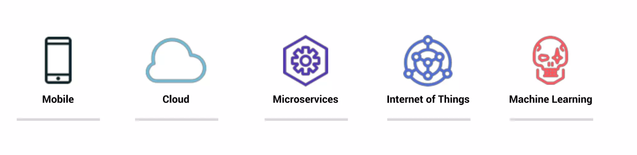
The World Has Changed
Business Digitalization Trends are driving the need to process events at a whole new scale, speed, and efficiency

Slide 71
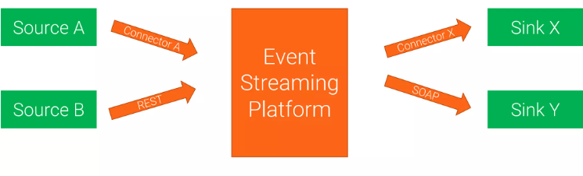
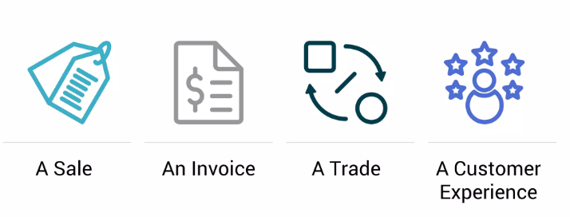
Event Streaming Platforms
Events

Slide 72
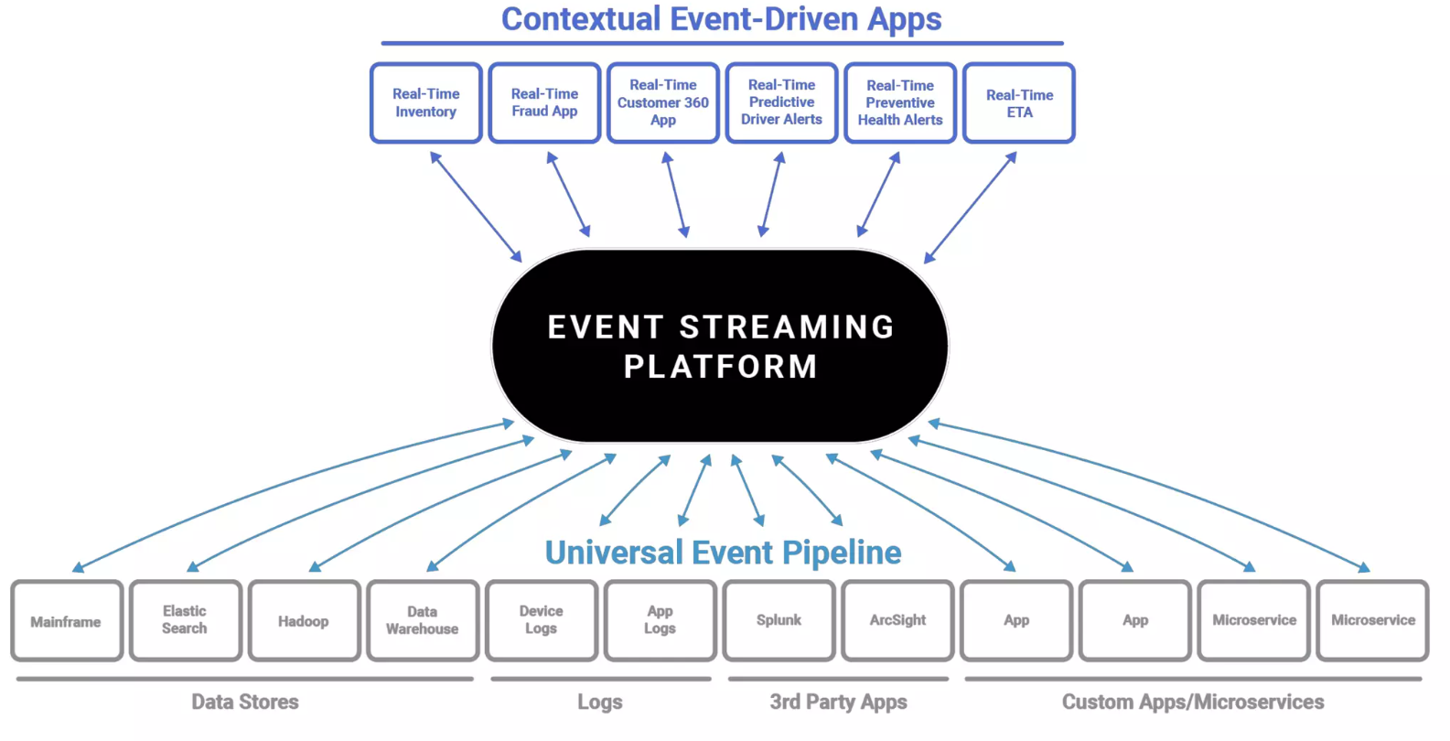

Slide 73
Benefits of API and web service integration
Scalability
Reusability
Interoperability
Efficiency
Security
Innovation

Slide 74
API and Web Service Security
Authentication
Authorization
Encryption
Rate Limiting
Input Validation
Monitoring and Logging
API Abuse
Vulnerability Management

Slide 75
Authentication and authorization mechanisms
OAuth: OAuth (Open Authorization) is an authorization framework that allows users to grant third-party applications access to their resources on a resource server without sharing their credentials.
OAuth uses access tokens to grant access to resources, and it allows users to grant specific permissions to third-party applications.
OAuth is widely used by social media platforms, cloud services, and other web applications.

Slide 76
Authentication and authorization mechanisms
JWT: JWT (JSON Web Token) is a compact, URL-safe means of representing claims to be transferred between two parties.
JWTs are used for authentication and authorization purposes, and they are self-contained tokens that contain all the necessary information to verify a user's identity and access privileges.
JWTs are widely used in modern web applications and APIs because they are lightweight, easy to implement, and can be used across different programming languages and platforms.

Slide 77
Best practices for securing APIs and web services
Use Strong Authentication and Authorization Mechanisms
Implement Encryption
Implement Input Validation
Implement Rate Limiting
Implement Monitoring and Logging
Use API Gateways and Proxies
Implement API Abuse Prevention
Regularly Test for Vulnerabilities
Implement Secure Development Practices

Slide 78
API management and documentation

Slide 79
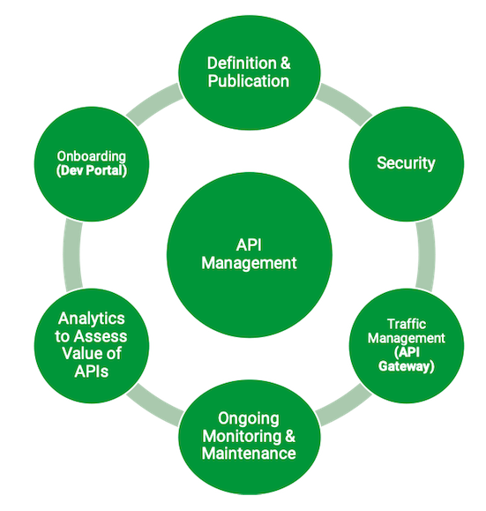
API management
API management refers to the process of designing, deploying, and maintaining APIs.
API management includes tasks such as API versioning, security, performance monitoring, and analytics.

Slide 80
API management
API management tools can help automate these tasks and provide a unified interface for managing APIs.
API management tools can also provide features such as API gateways, which can help manage and secure API traffic between client applications and back-end services.
API management can help ensure that APIs are secure, scalable, and reliable, and can help organizations monitor and optimize API performance.

Slide 81
Key features of API Management
API management includes a range of key features that are essential for effective API design, deployment, and management.
Here is an overview of some of the key features:
API Gateway is a software layer that provides a single point of entry for APIs, allowing them to be managed and secured in a centralized location.
Analytics and Monitoring tools can help organizations track API usage, performance, and other metrics.
Security is critical to ensuring that APIs are protected from unauthorized access and data breaches.
Developer Portal is a centralized location where developers can find documentation, support, and resources related to APIs.

Slide 82
Best practices for API documentation
Effective API documentation is essential for ensuring that APIs are usable and adopted by developers.
Here's an overview of some best practices for API documentation:
Use of clear and concise language
Provision of examples and use cases
Use of consistent formatting
By following these best practices, organizations can improve the usability and adoption of their APIs in several ways:
Improved understanding
Faster development
Increased adoption
Better user experience

Slide 83
API Documentation
API documentation refers to the process of creating and maintaining documentation for APIs. API documentation can include information such as API endpoints, parameters, data formats, and authentication requirements.
API documentation can help developers understand how to use an API and can help ensure that APIs are used correctly.

Slide 84
API Documentation
API documentation should be clear, concise, and up-to-date. It should provide examples of how to use the API and should include information on error handling and troubleshooting.
API documentation can be provided in a variety of formats, such as HTML, PDF, or Markdown, and can be generated automatically using tools such as Swagger or OpenAPI.

Slide 85
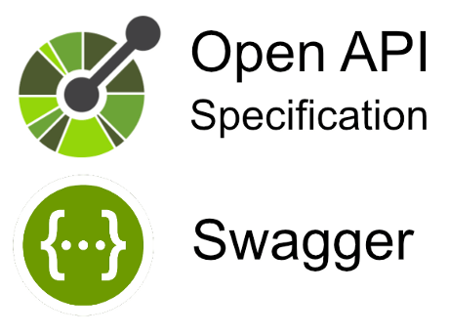
API documentation tools
Swagger / OpenAPI
An open standard for describing RESTful APIs.
It provides a specification for describing the structure and functionality of APIs, which can be used to generate documentation, code, and other artifacts.
Swagger / OpenAPI tools can help automate the documentation process, increase consistency, and improve accuracy by generating documentation directly from the API specification.
Swagger / OpenAPI tools are widely used and have a large community of users and contributors.
Pros:
Large community support
Open standard with wide adoption
Supports a range of programming languages and frameworks
Cons:
Can be complex to set up and configure
Limited support for non-RESTful APIs

Slide 86

API documentation tools
RAML
(RESTful API Modeling Language) is a YAML-based language for describing RESTful APIs.
It provides a simple and intuitive syntax for describing API resources, parameters, and responses.
RAML tools can help automate the documentation process, increase consistency, and improve accuracy by generating documentation directly from the RAML specification.
Pros:
Simple and intuitive syntax
Supports a range of programming languages and frameworks
Built-in support for API mocking and testing
Cons:
Smaller community compared to other tools
Limited support for non-RESTful APIs

Slide 87

API documentation tools
API Blueprint
a markup language for describing RESTful APIs.
It provides a simple and human-readable syntax for describing API resources, parameters, and responses.
API Blueprint tools can help automate the documentation process, increase consistency, and improve accuracy by generating documentation directly from the API Blueprint specification.
Pros:
Simple and easy-to-understand syntax
Supports a range of programming languages and frameworks
Built-in support for API mocking and testing
Cons:
Smaller community compared to other tools
Limited support for non-RESTful APIs

